Slide 1
Reading report for continuous attractor network[1]
Leman FENG
Mars 2018
[1] Sandro Romani and Misha Tsodyks. Continuous attractors with morphed/correlated
maps. PLoS computational biology, 6(8):e1000869, 2010.

Slide 2
Introduction
Background
Hopfield network
Attractor network
Continuous Attractor network
Network structure
Dynamics
Attractors
Turning curves
Morph sequence
Conclusion

Slide 3
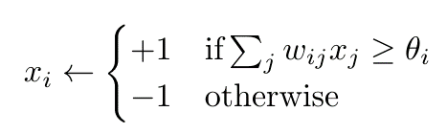
Background
Hopfield network
A set of neurons
Binary value
Symmetrical weights
Discrete time

Slide 4
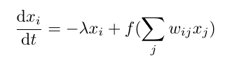
Background
Attractor network
A set of neurons
Real value
Symmetrical weights
Continuous in time

Slide 5
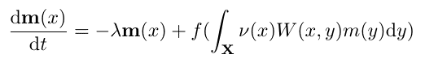
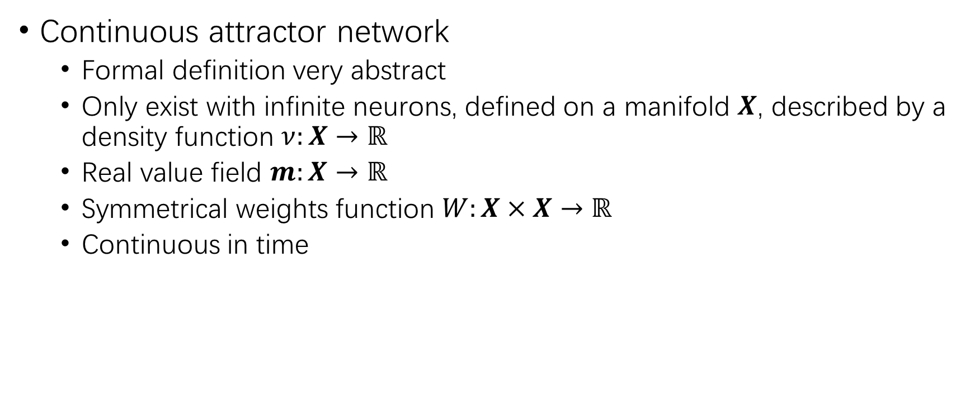
Background
Continuous attractor network
Formal definition very abstract
Only exist with infinite neurons, defined on a manifold $X$, described by a density function $ν:X→ℝ$
Real value field $m:X→ℝ$
Symmetrical weights function $W:X×X→ℝ$
Continuous in time

Slide 6
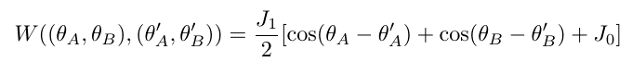
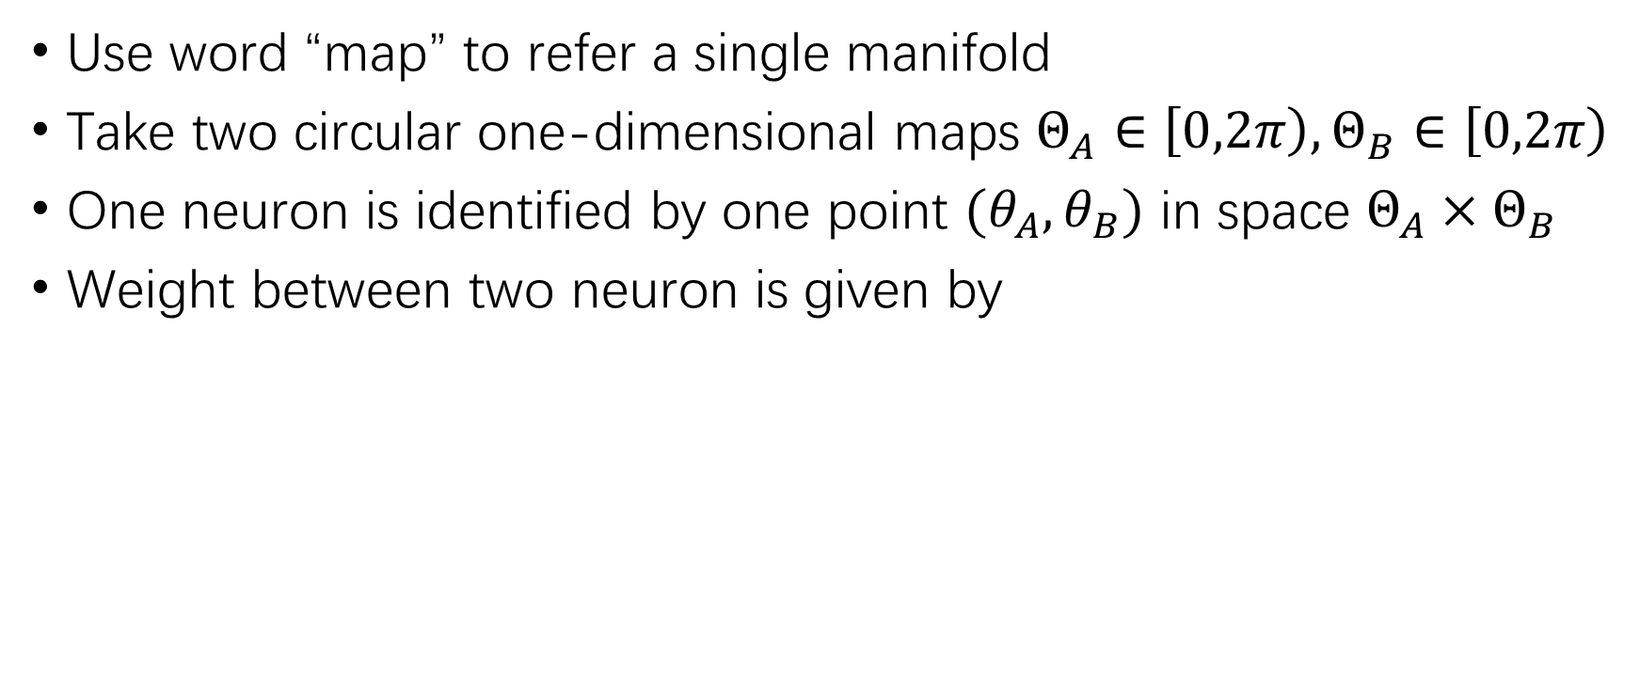
Network structure
Use word “map” to refer a single manifold
Take two circular one-dimensional maps $Θ_{A}∈\left[0,2π\right),Θ_{B}∈\left[0,2π\right)$
One neuron is identified by one point $(θ_{A},θ_{B})$ in space $Θ_{A}×Θ_{B}$
Weight between two neuron is given by

Slide 7
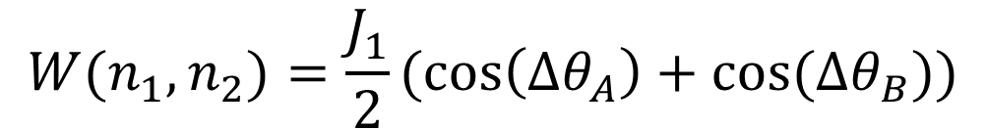
Neuron1
Neuron2
Map A
Map B
$$W(n_{1},n_{2})=\frac{J_{1}}{2}(\cos\left(Δθ_{A}\right)+cos⁡(Δθ_{B}))$$

Slide 8
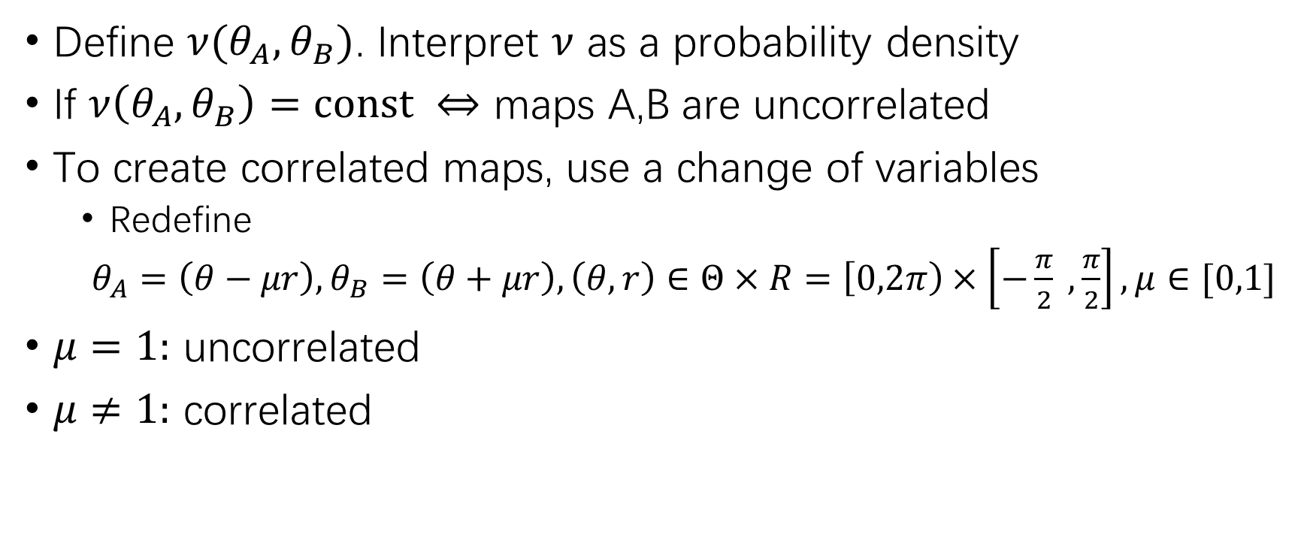
Network structure
Define $ν(θ_{A},θ_{B})$. Interpret $ν$ as a probability density
If $ν\left(θ_{A},θ_{B}\right)=const ⇔$ maps A,B are uncorrelated
To create correlated maps, use a change of variables
Redefine
$θ_{A}=\left(θ−μr\right),θ_{B}=\left(θ+μr\right), \left(θ,r\right)∈Θ×R=\left[0,2π\right)×\left[−\frac{π}{2} ,\frac{π}{2}\right],μ∈[0,1]$
$μ=1:$ uncorrelated
$μ≠1:$ correlated

Slide 9
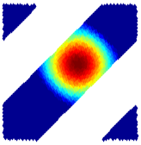
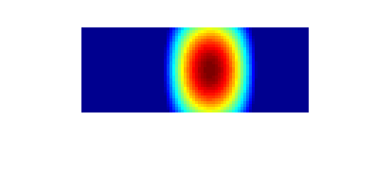

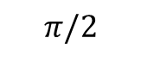
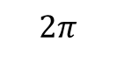
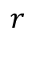
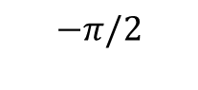
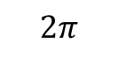
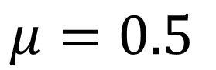
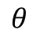
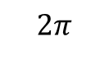
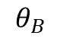

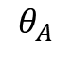

$$2π$$
$$π/2$$
$$r$$
$$θ_{B}$$
$$−π/2$$
$$0$$
$$2π$$
$$θ$$
$$0$$
$$0$$
$$2π$$
$$θ_{A}$$
$$μ=0.5$$

Slide 10
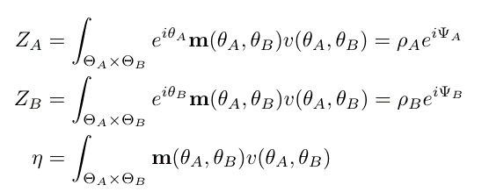
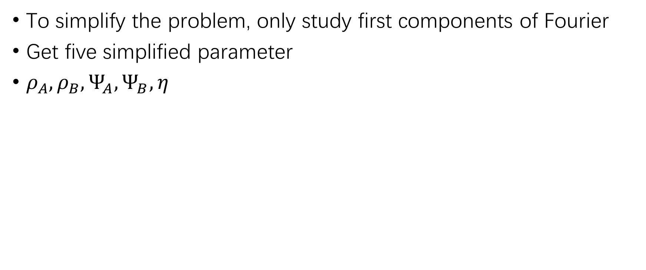
Dynamics
To simplify the problem, only study first components of Fourier
Get five simplified parameter
$ρ_{A},ρ_{B},Ψ_{A},Ψ_{B},η$

Slide 11
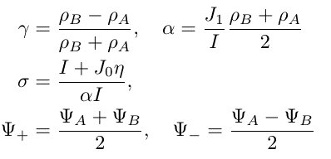
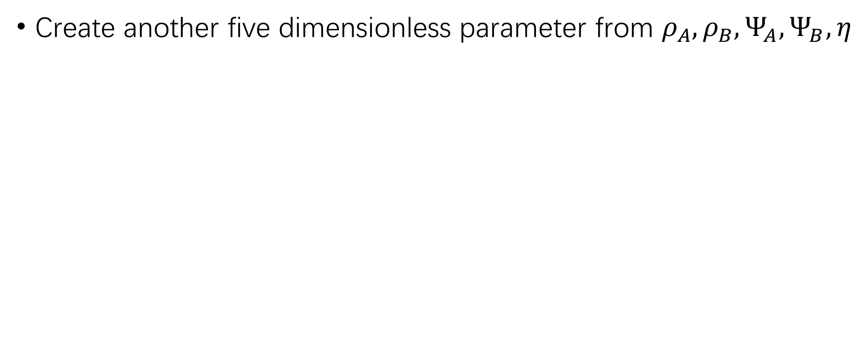
Dynamics
Create another five dimensionless parameter from $ρ_{A},ρ_{B},Ψ_{A},Ψ_{B},η$

Slide 12
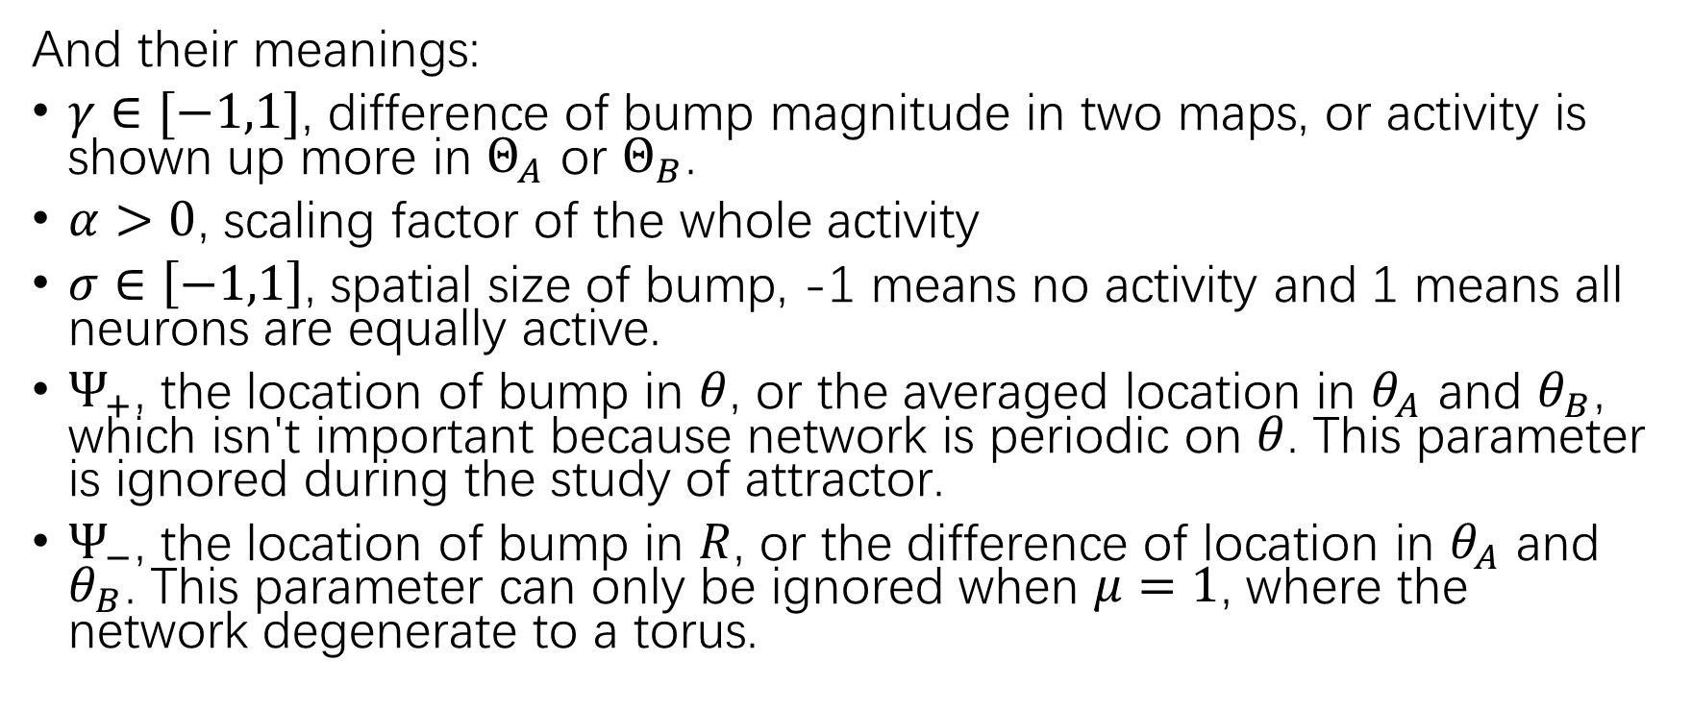
Dynamics
And their meanings:
$γ∈[−1,1]$, difference of bump magnitude in two maps, or activity is shown up more in $Θ_{A}$ or $Θ_{B}$.
$α>0$, scaling factor of the whole activity
$σ∈\left[−1,1\right]$, spatial size of bump, -1 means no activity and 1 means all neurons are equally active.
$Ψ_{+}$, the location of bump in $θ$, or the averaged location in $θ_{A}$ and $θ_{B}$, which isn't important because network is periodic on $θ$. This parameter is ignored during the study of attractor.
$Ψ_{−}$, the location of bump in $R$, or the difference of location in $θ_{A}$ and $θ_{B}$. This parameter can only be ignored when $μ=1$, where the network degenerate to a torus.

Slide 13
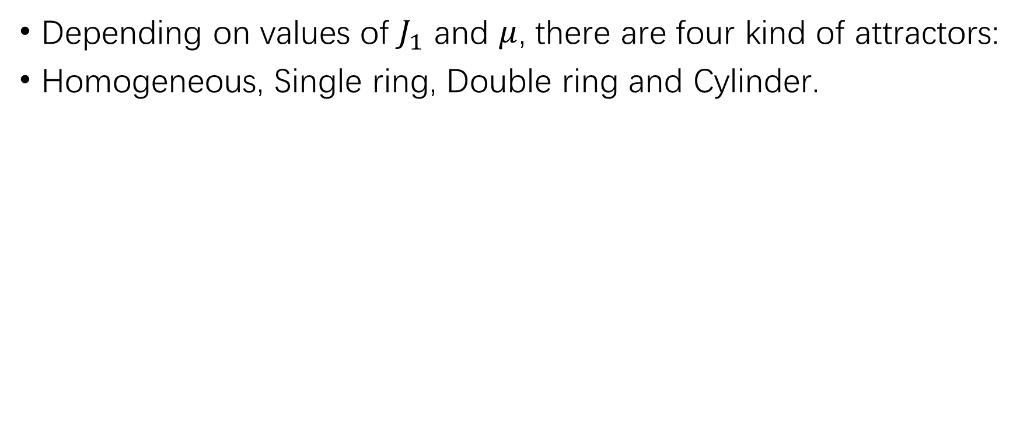
Attractors
Depending on values of $J_{1}$ and $μ$, there are four kind of attractors:
Homogeneous, Single ring, Double ring and Cylinder.

Slide 14
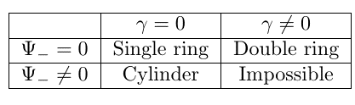
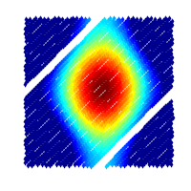
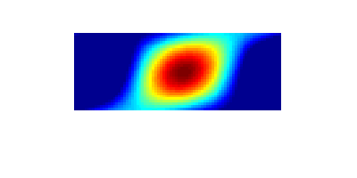
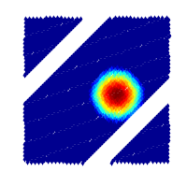


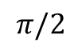
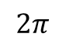
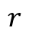
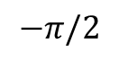
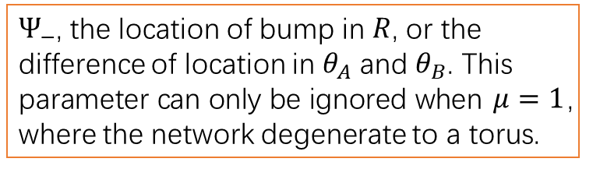
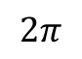
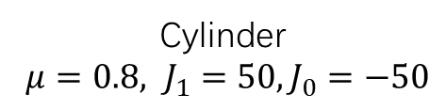
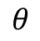
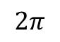
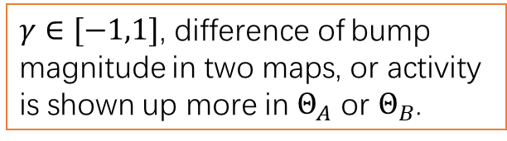
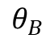
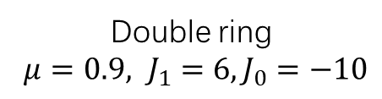

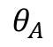

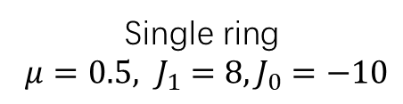
Simulation in matlab :
$$2π$$
$$π/2$$
$$r$$
$$θ_{B}$$
$$−π/2$$
$$0$$
$$2π$$
$γ∈[−1,1]$, difference of bump magnitude in two maps, or activity is shown up more in $Θ_{A}$ or $Θ_{B}$.
$$θ$$
$$0$$
$$0$$
$$2π$$
Single ring
$μ=0.5, J_{1}=8, J_{0}=−10$
$$θ_{A}$$
Double ring
$μ=0.9, J_{1}=6, J_{0}=−10$
$Ψ_{−}$, the location of bump in $R$, or the difference of location in $θ_{A}$ and $θ_{B}$. This parameter can only be ignored when $μ=1$, where the network degenerate to a torus.
Cylinder
$μ=0.8, J_{1}=50, J_{0}=−50$

Slide 15
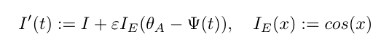
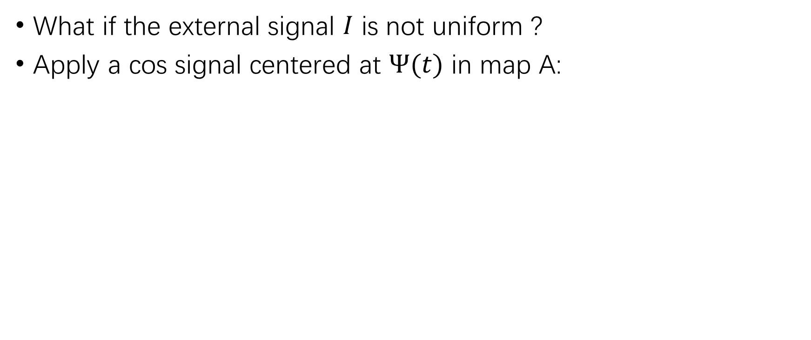
Turning curves
What if the external signal $I$ is not uniform ?
Apply a cos signal centered at $Ψ(t)$ in map A:

Slide 16
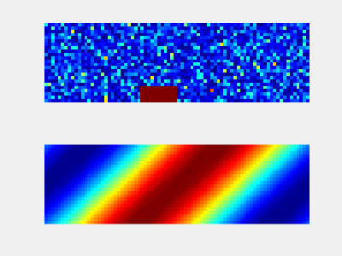
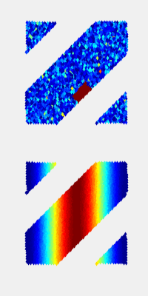
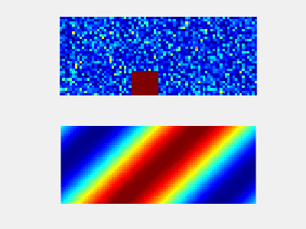
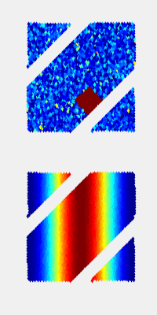

Turning curves
If $Ψ(t)$ is constant
For single ring and double ring attractor’s bump position in both $Θ_{A},Θ_{B}$ equals to $Ψ(t)$
For Cylinder attractor, position of bump in $Θ_{B}$ is free to move
Single ring with fixed input
Cylinder with fixed input

Slide 17





Turning curves
If $Ψ(t)$ is moving $Ψ\left(t\right)=vt$
For Cylinder attractor, position of bump in activity depend also on the history of input.
Single ring with moving input
Double ring with moving input

Slide 18


Cylinder with moving input

Slide 19
Cylinder
Single ring
Double ring

Slide 20

Morph sequence
Two equivalent descriptions of maps and neurons
Neurons’ existence is independent from maps. Neurons are put in maps, and weights between neurons are the sum of weights between their appearance in all maps.
Neurons exist in the space formed by Cartesian product of all maps.
Use not only two maps, but a infinite maps which is a morph sequence between $Θ_{A}$ and $Θ_{B}$.

Slide 21
Neuron1
Neuron2
Map A
Map B
$$W(n_{1},n_{2})=\frac{J_{1}}{2}(\cos\left(Δθ_{A}\right)+cos⁡(Δθ_{B}))$$

Slide 22

Neuron1
Neuron2
Map -1
Map 1
$$W(n_{1},n_{2})=\frac{J_{1}}{p}\sum_{i=1}^{p}{cos⁡(Δθ_{i})}$$

Slide 23
Conclusion
This paper studies a special case of continuous attractor network. Neurons exist in multiple maps. And the result shows that the external signal in one map can have influences on other maps, depend on the correlation between maps. And for some attractors, the activity of network can depend not only the external signal, but also the history of external signal.

